Slide 1
WIND
By Ted Hughes
GCESE Bitesize
http://www.bbc.co.uk/schools/gcsebitesize/english_literature/poetryplace/windrev6.shtml

Slide 2
WIND
This house has been far out at sea all night, The woods crashing through darkness, the booming hills, Winds stampeding the fields under the window Floundering black astride and blinding wet
Till day rose; then under an orange sky The hills had new places, and wind wielded Blade-light, luminous black and emerald, Flexing like the lens of a mad eye.
At noon I scaled along the house-side as far as The coal-house door. Once I looked up - Through the brunt wind that dented the balls of my eyes The tent of the hills drummed and strained its guyrope,
The fields quivering, the skyline a grimace, At any second to bang and vanish with a flap; The wind flung a magpie away and a black- Back gull bent like an iron bar slowly. The house
Rang like some fine green goblet in the note That any second would shatter it. Now deep In chairs, in front of the great fire, we grip Our hearts and cannot entertain book, thought,
Or each other. We watch the fire blazing, And feel the roots of the house move, but sit on, Seeing the window tremble to come in, Hearing the stones cry out under the horizons.

Slide 3
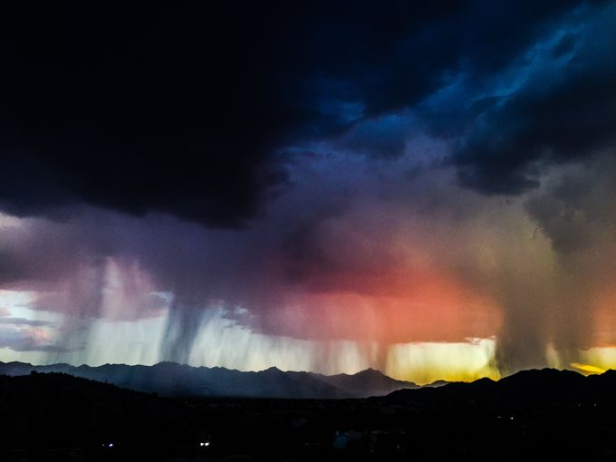
Subject
Wind is from Hughes' very first published collection of poems, Hawk in the Wind (1957). Like so many of his poems, Wind is related to nature, particularly as it appeared in his childhood setting of West Yorkshire. His parents lived in a house high on a ridge which was exposed to gales. The poem explores the effect of a strong, incessant wind on the narrator as he shelters indoors.

Slide 4
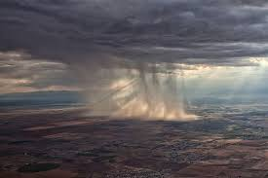
Structure and Language
Form
Wind consists of six, four-line stanzas (known as quatrains).
There is no clear use of consistent rhyme or rhythm.

Slide 5
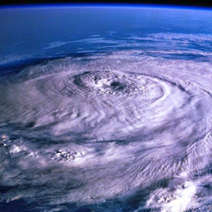
Structure
The poem is in chronological order; this is quite important as the first three stanzas each indicate a particular time: "all night... the day rose... at noon."
By the final stanza, there is a "fire blazing,“ which might indicate a further lapse in time.
At first glance, with its reasonably standard quatrains, Wind looks like a tidy, ordered poem. There is regular use of enjambment as lines from the end of stanzas run into the next.

Slide 6
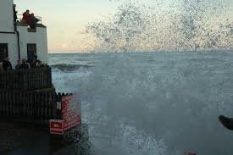
Sound
Hughes uses a mixture of techniques to create a specific sound. The most obvious, although not the most common, is onomatopoeia, for example:
The woods crashing through darkness, the booming hills
Winds stampeding the fields under the window
Floundering black astride and blinding wet
Hughes also uses alliteration, for example: "wind wielded."

Slide 7
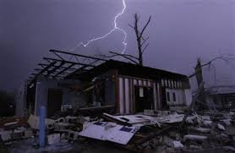
Metaphor
Hughes uses a metaphor in line one: “This house has been far out at sea all night."
Of course, the house hasn't actually been uprooted and set sail. Hughes uses this metaphor to create a sense of isolation and instability, like being "far out at sea." The wind has cut his family off from the rest of the world.
“At noon I scaled along the house-side as far as/The coal-house door…”
This is another metaphor. Hughes likens moving alongside of the house to the effort of "scaling" a mountain because the wind is so strong. Note how "house-side" is deliberately worded like “mountainside.”

Slide 8
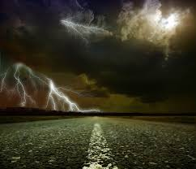
Personification
“The woods crashing through darkness, the booming hills,/Winds stampeding the fields…”
Hughes brings the woods, hills and winds to life so that their presence in the poem is more powerful.
The power of the storm and its ability to create fear is reflected through personification in the final line:
“Hearing the stones cry out under the horizons.”
Even the impassive, inanimate, lifeless stones "cry out" in fear.

Slide 9
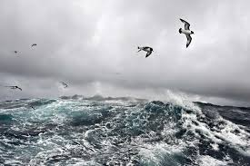
Attitudes and Ideas
Humanity is occasionally at the mercy of nature. All we can do at times is hope for the best and be reassured that the houses we have built are strong enough to endure the weather. There is a savage beauty about the wind and humanity is insignificant in the face of this awesome power. In fact, other elements in nature - woods, hills, fields, birds, stones - are overwhelmed by the wind too.

Slide 10
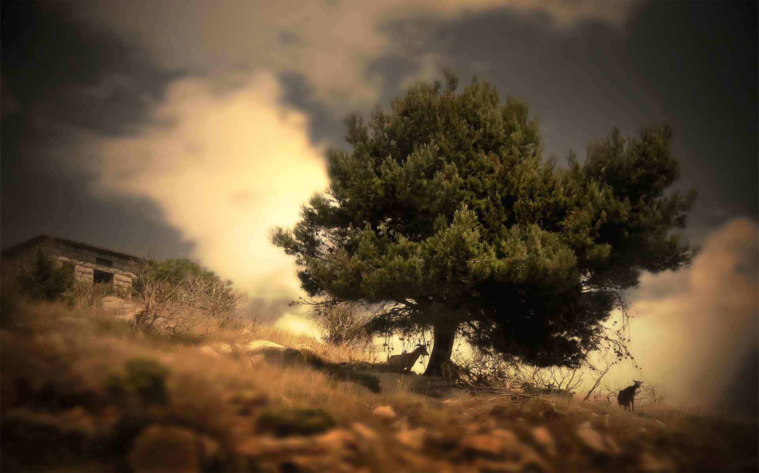
Themes
Nature: Nature is incredibly powerful and beautiful, but can be equally destructive and savage.
Power: This poem is unusual as it is not only humanity that is made to look insignificant or powerless in the face of nature, other natural elements are at the mercy of the wind. Perhaps the wind is the most powerful of all of nature's offerings?

Slide 11
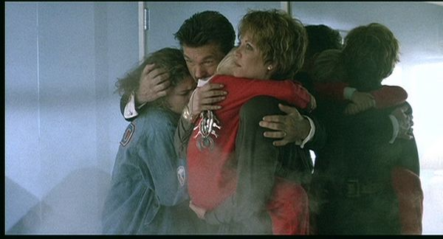
Exam
On your exam you will be asked to compare a certain aspect of one poem with another. In order to do this, we need to get to know this poem a bit better by considering one of its main aspects.
What follows is a sample question that concentrates on one feature of the poem and an answer (not necessarily complete) to the question.

Slide 12
Explain the relationship between humanity and nature in Wind.
This poem depicts an uneven relationship between humanity and nature. Humans, perhaps used to being dominant, are reminded that they are powerless in the face of nature (in this case, the wind) in full flight.
Humankind builds houses as protection from natural elements, such as the weather, but in this case the wind is so savage that the house seems to be under threat.
The poem opens with:
This house has been far out to sea all night
This creates a sense of isolation, instability and perhaps even panic, which is confirmed in the last stanza:
...We watch the fire blazing,/And feel the roots of the house move, but sit on,/Seeing the window tremble to come in,
There is a sense of threat and imminent danger here - but such is humankind's insignificance that we have no power to do anything about it. Humanity is at the mercy of nature and all its power.

Slide 13
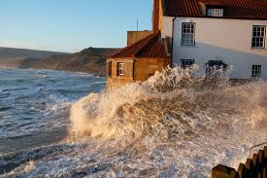
The poem opens with:
“This house has been far out to sea all night…”
This creates a sense of isolation, instability and perhaps even panic, which is confirmed in the last stanza:
“...We watch the fire blazing,/And feel the roots of the house move, but sit on,/Seeing the window tremble to come in,…”
There is a sense of threat and imminent danger here - but such is humankind's insignificance that we have no power to do anything about it. Humanity is at the mercy of nature and all its power.

Slide 14
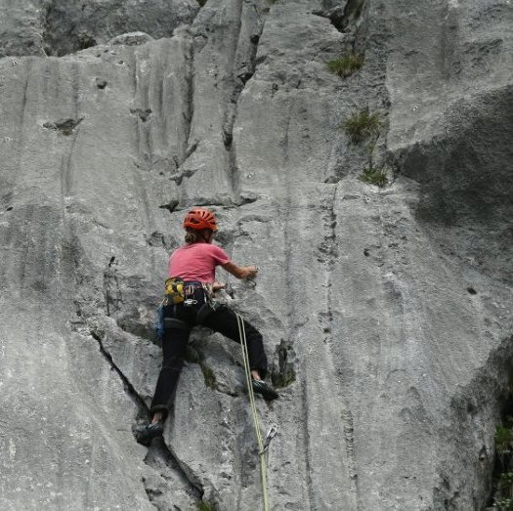
The third stanza emphasizes this unequal power relationship:
“At noon I scaled along the house-side as far as/The coal-house door.”
The narrator describes how fetching coal is akin to mountaineering: he does not walk to the coal-house door - that is impossible - instead he clings to the side of the house as if it's a great peak.

